Slide 1
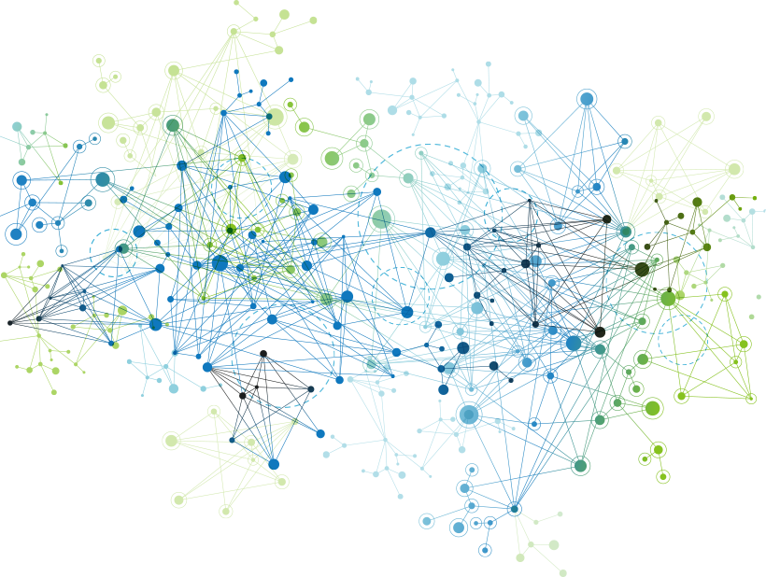

Efficient Graph Knowledge Discovery on Graph Streams with Concept Drift
Ramesh Paudel
Ph.D. Dissertation Defense
April 2, 2020
Committee:
Dr. William Eberle (Advisor)
Dr. Douglas Talbert
Dr. Gerald C. Gannod
Dr. Martha Kosa
Dr. Allan Mills

Slide 2
Outline
Graph Mining Overview
Challenges
&
Motivation
Graph Representation
Concept Drift
Detection
Graph Stream
Classification
Conclusion
Contributions

Slide 3
Outline
Graph Mining Overview
Challenges
&
Motivation
Graph Representation
Concept Drift
Detection
Graph Stream
Classification
Conclusion

Slide 4
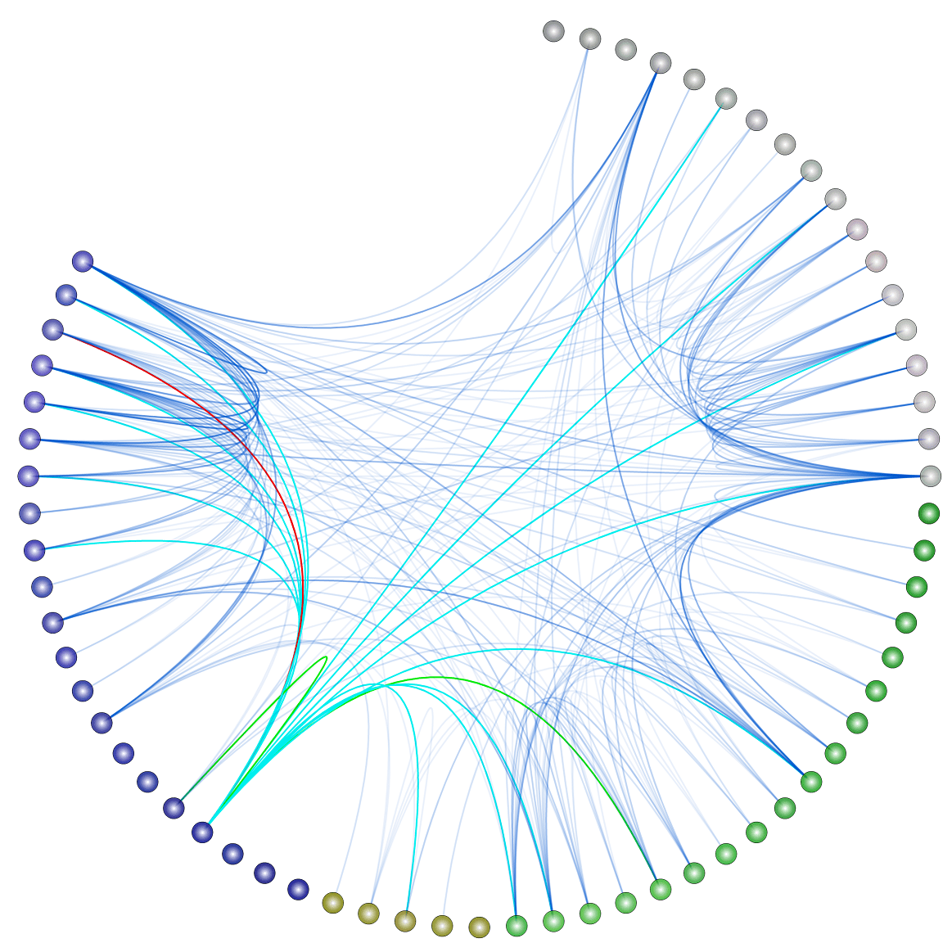
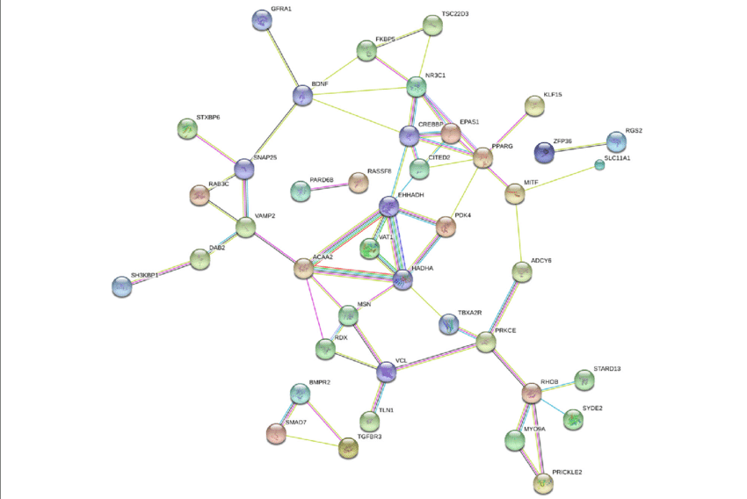

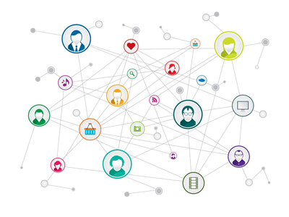
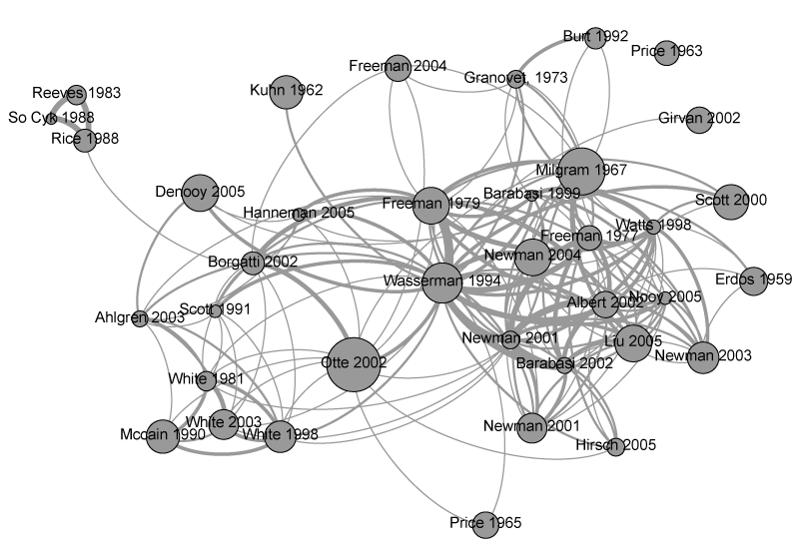

Graphs Are Everywhere
Chemical Compounds
Co-purchase Network
Computer Network
Protein Interaction
Citation Network
Social Network
Internet of Things

Slide 5
Why Graphs?
LINK PREDICITION
COMMUNITY DETECTION
Predict how a network will evolve
Suggests friend in social network
Recommend products in an
e-commerce network
Group or clusters of nodes
Detect same pages in WWW
Detect user segment in e-commerce
GRAPH MINING
NODE CLASSIFICATION
ANOMALY DETECTION
Infer incomplete node attribute by looking at similar node
Infer hidden information in social network
Identify patterns that do not align with a notion of normal behavior.
Notes:
Another use case VISUALIZATION

Slide 6
Outline
Graph Mining Overview
Challenges
&
Motivation
Graph Representation
Concept Drift
Detection
Graph Stream
Classification
Conclusion

Slide 7
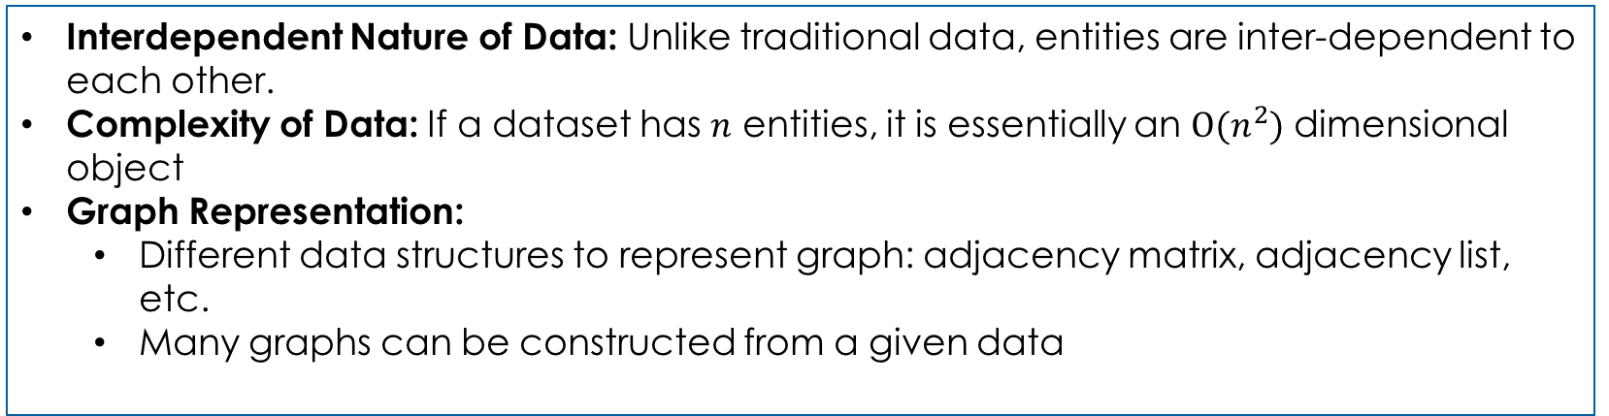
Issues in Graph Mining
Interdependent Nature of Data: Unlike traditional data, entities are inter-dependent to each other.
Complexity of Data: If a dataset has $n$ entities, it is essentially an $O(n^{2})$ dimensional object
Graph Representation:
Different data structures to represent graph: adjacency matrix, adjacency list, etc.
Many graphs can be constructed from a given data
Issues in Graph Stream
Data are available only once
Hard to store in the long run
Data will evolve over time resulting in deterioration of the model performance.
Notes:
Graph cannot be given as input to machine learning directly

Slide 8
Challenges in Graph Mining
How to represent graph data?
Extract informative, discriminating, and independent features that can represent graph data in a format used as an input to a machine learning model.
Preserve the original properties of a graph (like graph proximity) with high probability.
How to deal with streaming nature?
Represent graphs in fixed size vector so it is easy to store in long run.
In a streaming scenario, the data distribution can change over time (concept drift) resulting in deterioration of the model performance.
Detect such drift points so that the model remains relevant in the newer data.

Slide 9
Proposed Solution
Drift ?
Concept Drift Detection
Yes
G_{t}
Graph Stream
Graph Stream
Classification
y_{t}
Graph Representation
Sketch Vector

Slide 10
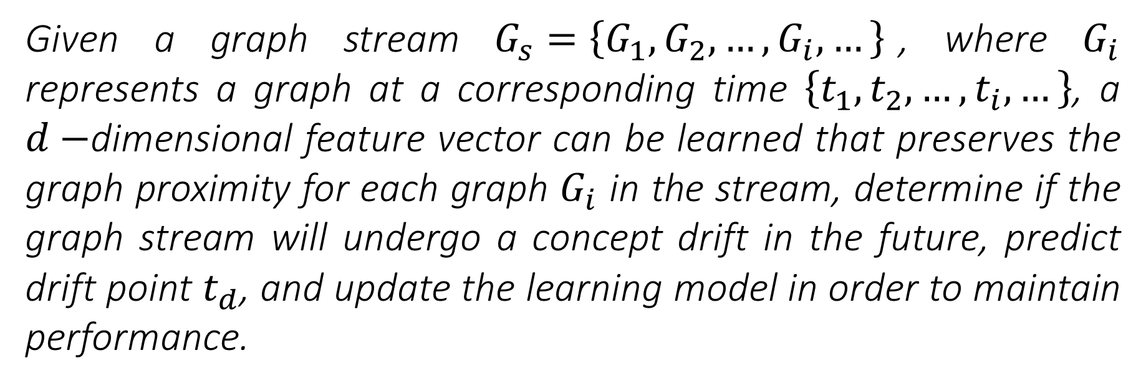
Hypothesis
Given a graph stream $G_{s}=\left\{G_{1},G_{2}, …,G_{i}, …\right\}$, where $G_{i}$ represents a graph at a corresponding time $\left\{t_{1},t_{2}, …,t_{i}, …\right\}$, a $d−$dimensional feature vector can be learned that preserves the graph proximity for each graph $G_{i}$ in the stream, determine if the graph stream will undergo a concept drift in the future, predict drift point $t_{d}$, and update the learning model in order to maintain performance.

Slide 11
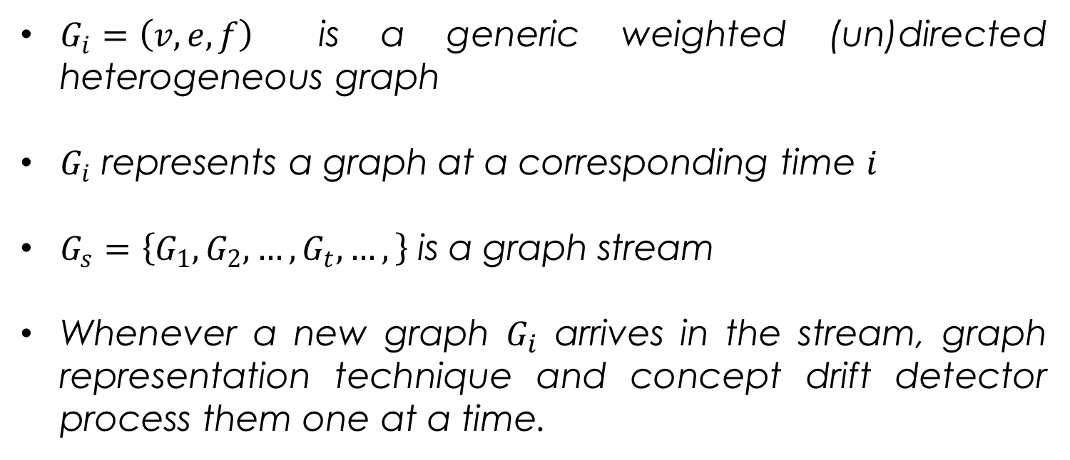
Preliminaries
$G_{i}=\left(v,e,f\right)$ is a generic weighted (un)directed heterogeneous graph
$G_{i}$ represents a graph at a corresponding time $i$
$G_{s}=\left\{G_{1},G_{2}, …,G_{t}, …,\right\}$ is a graph stream
Whenever a new graph $G_{i}$ arrives in the stream, graph representation technique and concept drift detector process them one at a time.

Slide 12
Proposed Solution
Drift ?
Concept Drift Detection
Yes
G_{t}
Graph Stream
Graph Stream
Classification
y_{t}
Graph Representation
Sketch Vector

Slide 13
Background
Graph Kernel
Evaluate the similarity by decomposing graphs into atomic substructures & defining a similarity function.
Atomic substructure like subgraph, random walk, subtree, etc.
Feature Vector
Graph Representation
Maps user-defined statistics, like degree, label, or neighborhood statistics, into a feature vector.
Graph Embedding
Transforms nodes, edges, subgraphs, graphs, and their features into a low dimensional vector space.
Automatic feature learning using a neural network, matrix factorization, etc.
Notes:
Graph Kernel:
evaluate the similarity between two graphs G1 and G2 by recursively decomposing them
into atomic substructures through
- random walks [82, 83],
- shortest paths [85],
- subgraphs [6],
- subtrees [88, 87], etc.,
and define a similarity function over the substructures (e.g., counting the number of
common substructures across G1 and G2).

Slide 14
Motivation
Graph Kernel
Issues
Atomic structures are extracted using well-defined functions.
Therefore, leads to very high dimensional, sparse, and non-smooth representations yielding poor generalization.
Issues with
Current Graph Representation Techniques
Feature Vector
Graph Embedding
Issues:
Lead to a loss in the topological information,
feature generation is time-consuming and expensive,
features generated beforehand cannot adapt during the learning process
Issues:
High computation cost
Focuses more on a node and edge embedding only (not on graph and subgraph)
Limited work in streaming graphs
Therefore, there is a need for a general-purpose graph representation technique that can represent graphs in streaming scenarios.
Notes:
Graph Kernel:
evaluate the similarity between two graphs G1 and G2 by recursively decomposing them
into atomic substructures through
- random walks [82, 83],
- shortest paths [85],
- subgraphs [6],
- subtrees [88, 87], etc.,
and define a similarity function over the substructures (e.g., counting the number of
common substructures across G1 and G2).

Slide 15
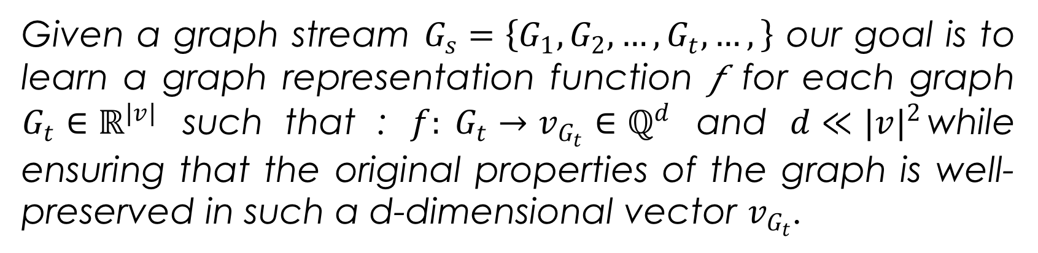
Problem Statement
Given a graph stream $G_{s}=\left\{G_{1},G_{2}, …,G_{t}, …,\right\}$ our goal is to learn a graph representation function 𝑓 for each graph $G_{t}∈ℝ^{|v|}$ such that : ${f: G}_{t}→v_{G_{t}}∈ℚ^{d}$ and $d≪{|v|}^{2}$while ensuring that the original properties of the graph is well-preserved in such a d-dimensional vector $v_{G_{t}}$.

Slide 16
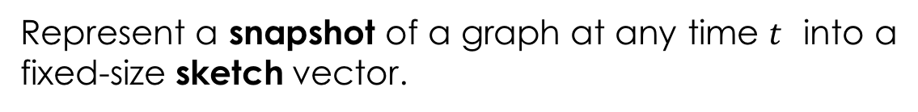
SNAPSKETCH
Represent a snapshot of a graph at any time $t$ into a fixed-size sketch vector.
Unsupervised graph representation technique.
SNAPSKETCH
Has constant memory space usage.
Graph representations learned by SNAPSKETCH can be used for downstream applications, such as graph classification, anomaly detection, community detection, etc.

Slide 17
SNAPSKETCH
Random Walk
Sketching
Perform a biased random walk to produce a 𝑛−shingle (like 𝑛−𝑔ram ).
Sketches a graph into a sketch vector by hashing random projection vector and a discriminative
𝑛−shingle’s cost vector

Slide 18
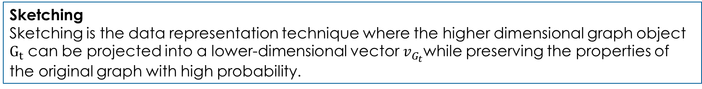
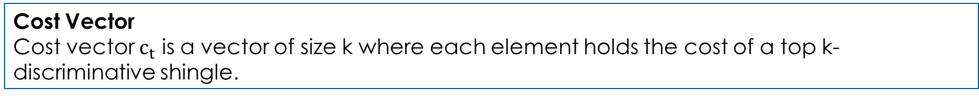
Preliminaries
Shingle
A shingle is a contiguous sub-sequence contained in a walk path.
n-Shingle
An n-shingle $S(v,n)$ is a sub-sequences of size 𝑛 constructed from a walk path.
Discriminative n-Shingle
An n-shingles with the highest frequency in a graph $G_{t}$ are called Discriminative n-shingles $S_{t}$.
Cost Vector
Cost vector $c_{t}$ is a vector of size k where each element holds the cost of a top k-discriminative shingle.
Sketching
Sketching is the data representation technique where the higher dimensional graph object $G_{t}$ can be projected into a lower-dimensional vector $v_{G_{t}}$while preserving the properties of the original graph with high probability.

Slide 19
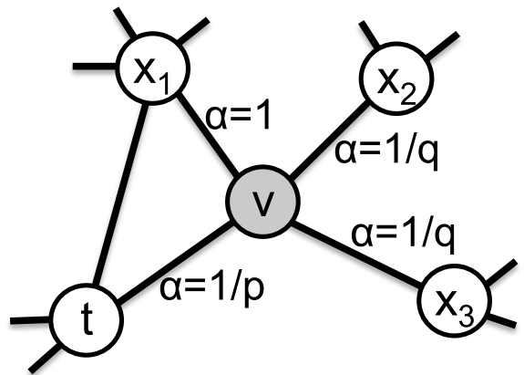
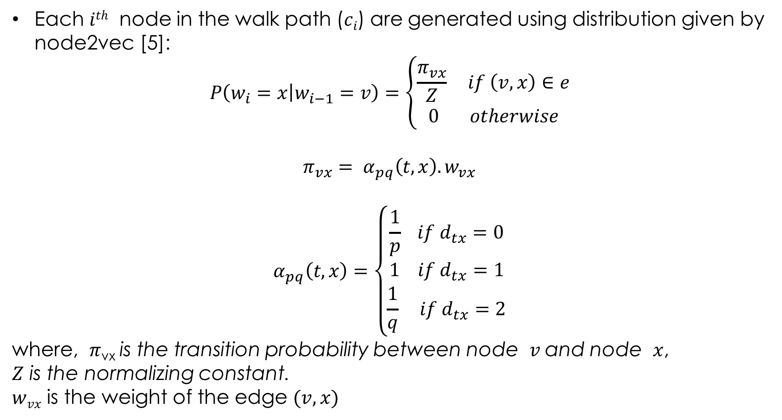
Random Walk
Each $ith$ node in the walk path ($ci$) are generated using distribution given by node2vec [5]:
$$P\left(w_{i}=x | w_{i−1}=v\right)=\left\{\begin{aligned}\frac{π_{vx}}{Z} if \left(v,x\right)∈e \\ 0 otherwise\end{aligned}\right.$$
$${π_{vx}= α}_{pq}\left(t,x\right).w_{vx}$$
$$α_{pq}\left(t,x\right)=\left\{\begin{aligned}\frac{1}{p} if d_{tx}=0 \\ 1 if d_{tx}=1 \\ \frac{1}{q} if d_{tx}=2\end{aligned}\right.$$
where, $π\text{vx}$ is the transition probability between node $v$and node $x$,
$Z$ is the normalizing constant.
$wvx$ is the weight of the edge $(v, x)$
[5]
Notes:
The parameter p controls the likelihood of revisiting an older node in the walk
The high value of q provides a walk with a local view (equivalent to BFS behavior)
a low value of q provides a walk away from the current node (equivalent to DFS behavior).

Slide 20
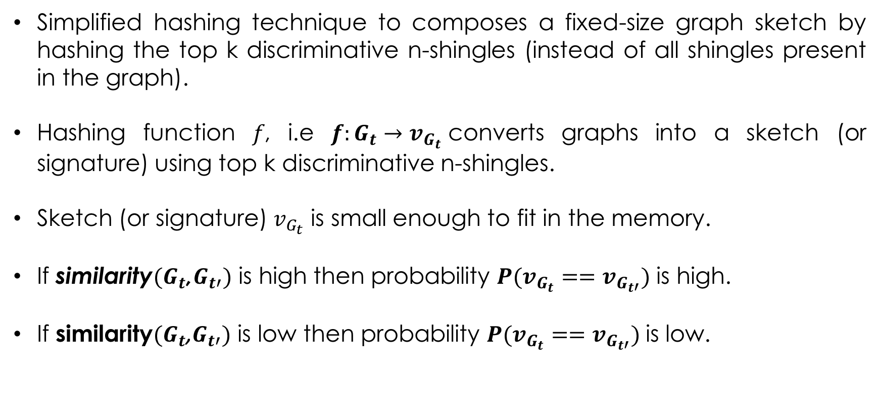
Hashing
Simplified hashing technique to composes a fixed-size graph sketch by hashing the top k discriminative n-shingles (instead of all shingles present in the graph).
Hashing function 𝑓, i.e $f:G_{t}→v_{G_{t}}$converts graphs into a sketch (or signature) using top k discriminative n-shingles.
Sketch (or signature) $v_{G_{t}}$ is small enough to fit in the memory.
If similarity$(G_{t}$,$G_{t′})$ is high then probability $P(v_{G_{t}}==v_{G_{t′}})$ is high.
If similarity${(G}_{t}$,$G_{t′})$ is low then probability $P(v_{G_{t}}==v_{G_{t′}})$is low.
Notes:
For using cosine similarity measure, Locality-Sensitive Hashing (LSH} called SimHash \cite{charikar2002similarity} can be used,
or for Jaccard similarity measure, MinHash \cite{broder1997resemblance} can be used.

Slide 21
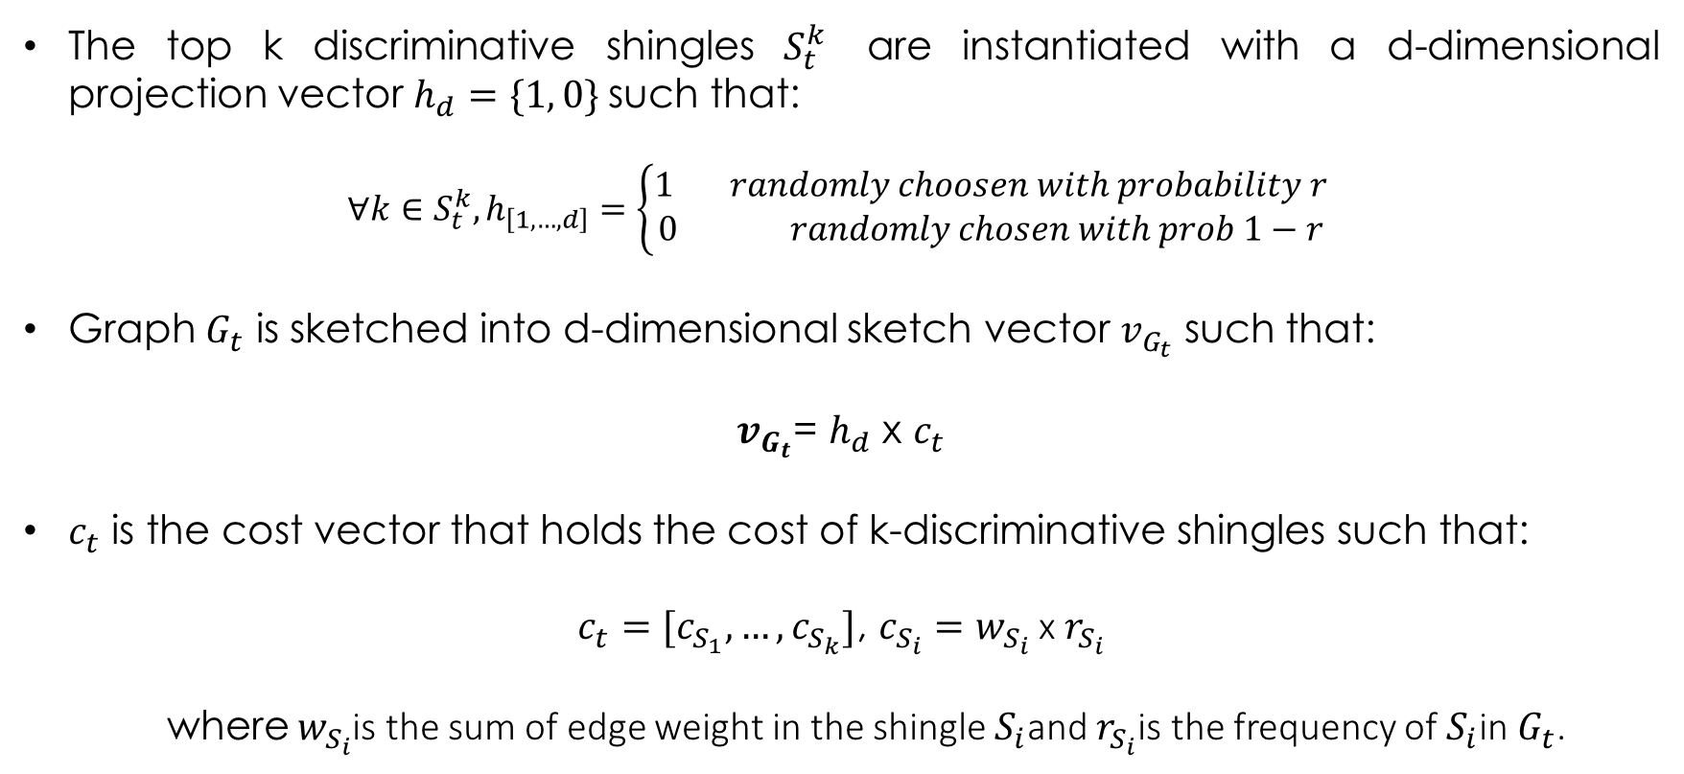
Hashing
The top k discriminative shingles $S_{t}^{k}$ are instantiated with a d-dimensional projection vector $h_{d}=\{1, 0\}$such that:
$$∀k∈S_{t}^{k}, h_{\left[1,…, d\right]}=\left\{\begin{aligned}1 randomly choosen with probability r \\ 0 randomly chosen with prob 1−r \end{aligned}\right.$$
Graph $G_{t}$ is sketched into d-dimensional sketch vector $v_{G_{t}}$ such that:
$v_{G_{t}}$= $h_{d}$ x $c_{t}$
$c_{t}$ is the cost vector that holds the cost of k-discriminative shingles such that:
$c_{t}=[c_{S_{1}}, …, c_{S_{k}}]$, $c_{S_{i}}=w_{S_{i}}$ x $r_{S_{i}}$
where $w_{S_{i}}$is the sum of edge weight in the shingle $S_{i}$and $r_{S_{i}}$is the frequency of $S_{i}$in $G_{t}$.
Notes:
For using cosine similarity measure, Locality-Sensitive Hashing (LSH} called SimHash \cite{charikar2002similarity} can be used,
or for Jaccard similarity measure, MinHash \cite{broder1997resemblance} can be used.

Slide 22
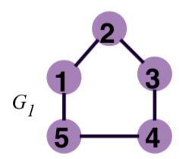
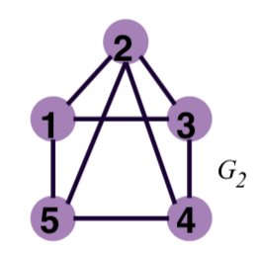
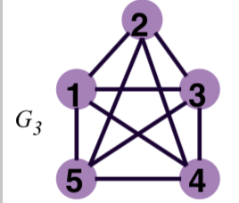
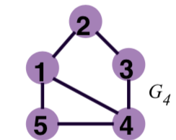
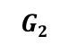
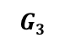
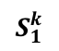
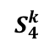
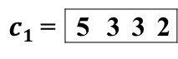
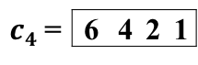
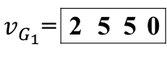
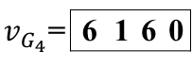

SNAPSKETCH Framework
H_{d}= [1 … d]
$$S_{1}^{k}$$
151
515
123
543
$c1$ = | 5 | 3 | 3 | 2
0 | 1 | 1 | 0
. | . | . | .
. | . | . | .
1 | 0 | 0 | 0
$v_{G_{1}}$= | 2 | 5 | 5 | 0
$$G2$$
. . . . . .
$$v_{G_{t}}=c_{t}×h_{d}$$
1 | 0 | 1 | 0
. | . | . | .
. | . | . | .
0 | 1 | 0 | 0
$v_{G_{4}}$= | 6 | 1 | 6 | 0
$$G3$$
123
515
145
543
$c4$ = | 6 | 4 | 2 | 1
$$S_{4}^{k}$$
H_{d}= [1 … d]

Slide 23
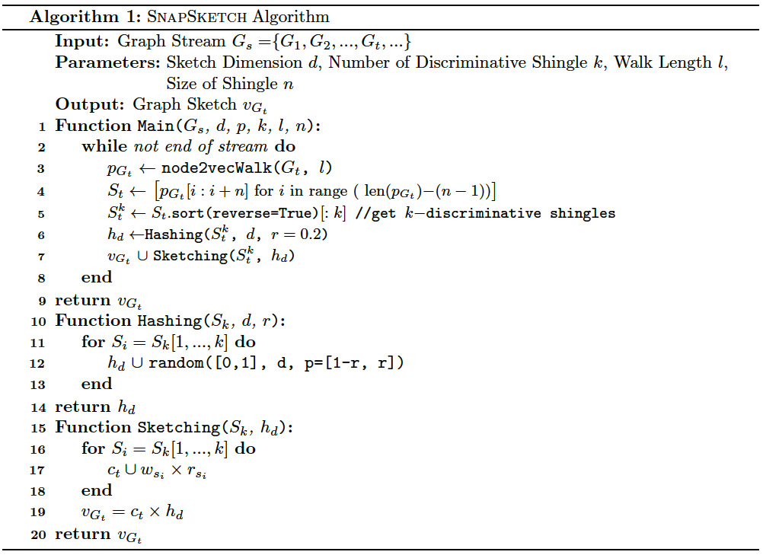
SNAPSKETCH
Notes:
discriminative shingle are the most frequent one

Slide 24
Experimentation
Graph Classification
Anomaly Detection
Notes:
discriminative shingle are the most frequent one

Slide 25
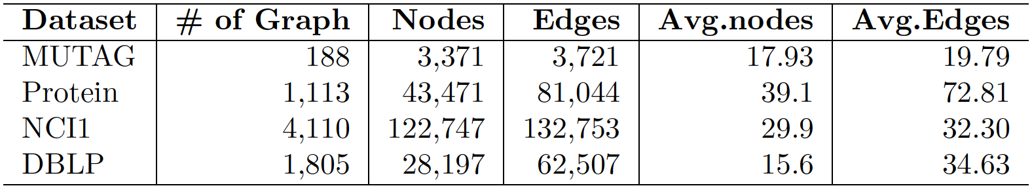
Graph Classification
Table: Dataset for Graph Classification
Fig: Graph representation of a chemical compound and its structure
Table: Graph representation of a DBLP citation network
Notes:
discriminative shingle are the most frequent one

Slide 26
Graph Classification
Baseline Approaches:
Weisfeiler-Lehman (WL) Graph Kernels [13]
Graph2vec [14]
Sub2vec[15]
Spotlight[2]
Experimental Setup:
SVM with rbf kernel, c=0.1, and gamma = 0.01 for graph classification.
10 fold cross validation
MacOS with 2.6 GHz Intel Core i5 processor and 8 GB main memory
For MUTAG, Protein, and NCI1 datasets: l = 50, n = 3, d = 32, and k = 256
For DBLP dataset, l = 50, n = 3, d = 32, and k = 16 will be used.
Notes:
discriminative shingle are the most frequent one
We did comprehensive parameter sensitivity test to confirm final parameters.
Based on graph structure (density and other, DBLP is loosely dense)
l = 50, n = 3, d = 32, and k = 256 for MUTAG, Protein, and NCI1 datasets
For DBLP dataset, l = 50, n = 3, d = 32, and k = 16 will be used.

Slide 27
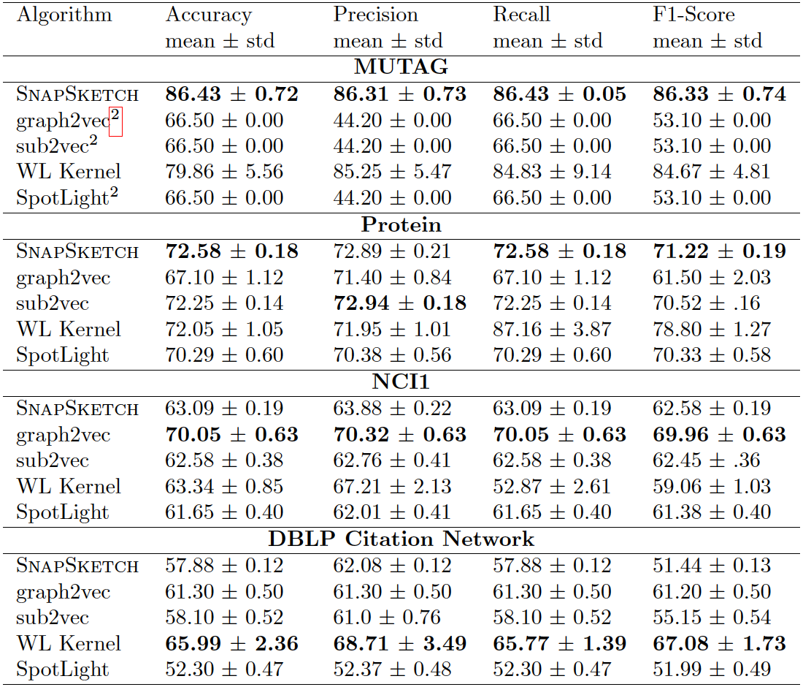
Classification Results
Table: Classification performance of SNAPSKETCH and baselines on graph classification datasets
Notes:
discriminative shingle are the most frequent one

Slide 28
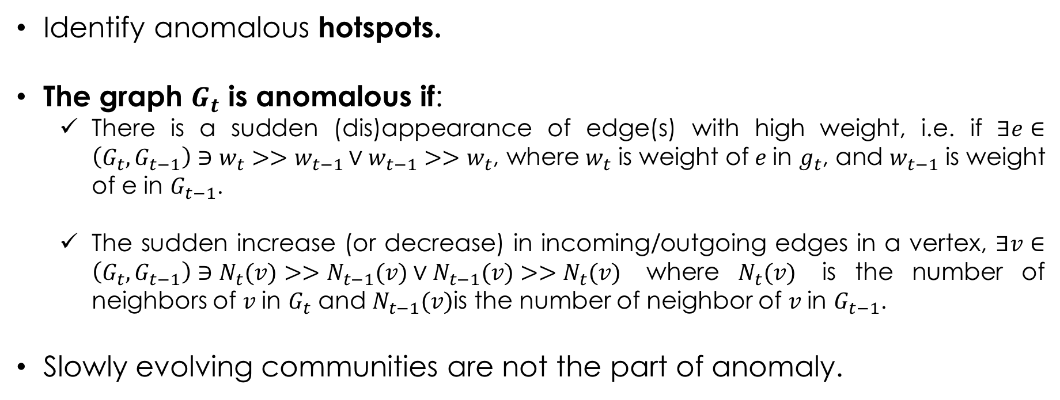
Anomaly Detection
Localized regions of certain activities
Identify anomalous hotspots.
The graph $G_{t}$ is anomalous if:
There is a sudden (dis)appearance of edge(s) with high weight, i.e. if $∃e∈\left(G_{t},G_{t−1}\right)∋w_{t}>>w_{t−1}∨w_{t−1}>>w_{t}$, where $w_{t}$ is weight of $e$in $g_{t}$, and $w_{t−1}$ is weight of e in $G_{t−1}$.
The sudden increase (or decrease) in incoming/outgoing edges in a vertex, $∃v∈\left(G_{t},G_{t−1}\right)∋N_{t}(v)>>N_{t−1}(v)∨N_{t−1}(v)>>N_{t}(v)$ where $N_{t}(v)$ is the number of neighbors of $v$in $G_{t}$ and $N_{t−1}(v)$is the number of neighbor of $v$in $G_{t−1}$.
Slowly evolving communities are not the part of anomaly.
Notes:
discriminative shingle are the most frequent one

Slide 29
Anomaly Detection
Detecting Anomalous Hotspots in Graphs can detect:-
Denial of Service (DoS) attacks, port scans, and other cyber-attacks in a computer network.
Unusual road traffic patterns related to holidays, events, accidents, etc.,
Spammer in a social network that acts fast to increase their page (or account) activities.
How it work?
A random walk in SNAPSKETCH is biased toward the denser edges.
The discriminative shingles take the snapshot of the hotspot region in the graph.
If k is chosen effectively it can represent the hotspot regions with high probability.
Notes:
discriminative shingle are the most frequent one

Slide 30
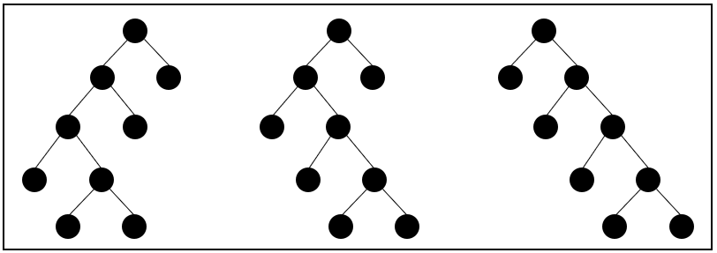
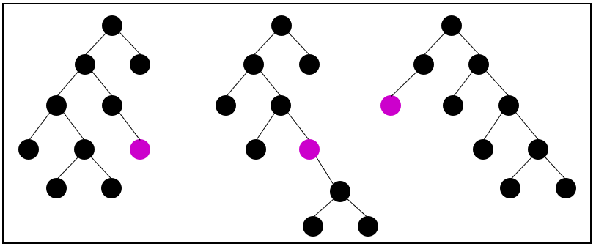
Anomaly Detection
The anomaly detection is performed by using Robust Random Cut Forests (RRCF) [1].
RRCF is an unsupervised ensemble method for detecting outliers in streaming data.
Also available in AWS SageMaker.
Anomaly score is the collusive displacement while adding new data points.
Detect DoS attack in network traffic and unusual road traffic patterns.

Slide 31
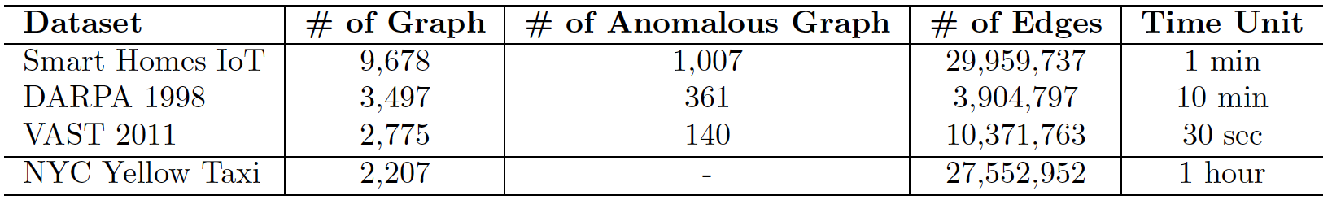
Dataset
Network Traffic
Smart Home IoT [4] : 1 week worth of data from the University of NSW, Sydney.
DARPA 1998: Seven weeks of data.
VAST 2011: Day 1 of Visual Analytics Science and Technology (VAST) 2011 Mini Challenge 2.
NYC Yellow Taxi Trip
NYC yellow taxi trip records over a 3 month period (Nov 2015-Jan 2016).
Anomalies in the data are holidays (Thanksgiving, Christmas, and New Year), events and unusual weather conditions (blizzard).
Notes:
Smart Home IoT :
28 IoT devices as well as non-IoT devices.
Each DoS attack lasts for 10 minutes and is launched with the maximum limit of 1, 10 or 100 packets per second.
DARPA 1998: 300 instances of 38 dierent automated attacks in seven week of training
VAST 2011 : DoS attack starts at 11:39 am and ends at 12:51 pm on day one i.e. the dataset
has one instance of a DoS attack that lasts almost 72 minutes

Slide 32
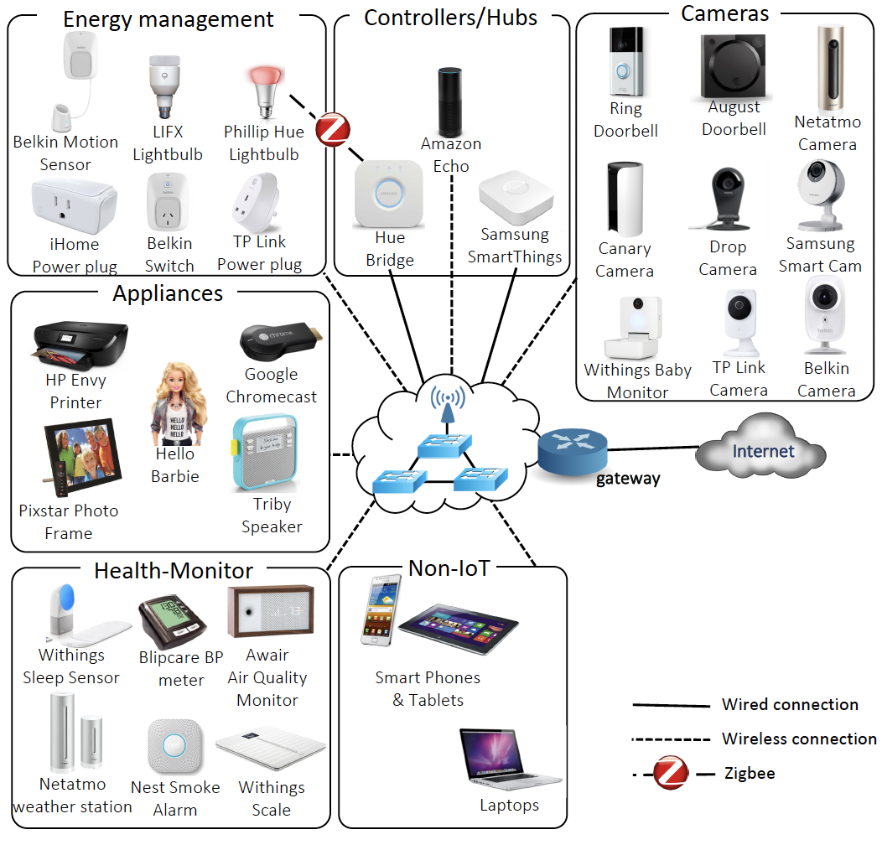
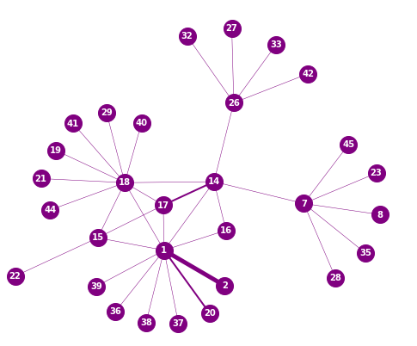
Data Preprocessing
﻿Fig: Smart Home IoT Data Collection Testbed [4]
﻿Fig: Graph Layout

Slide 33
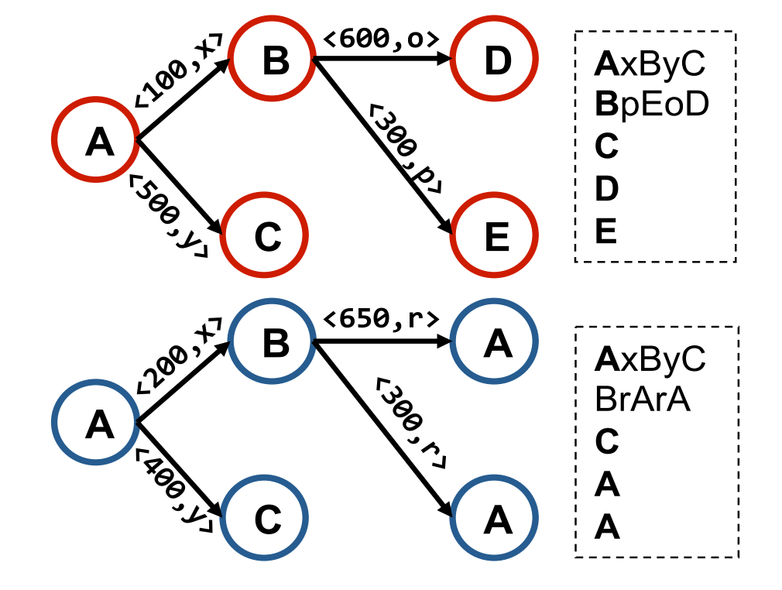
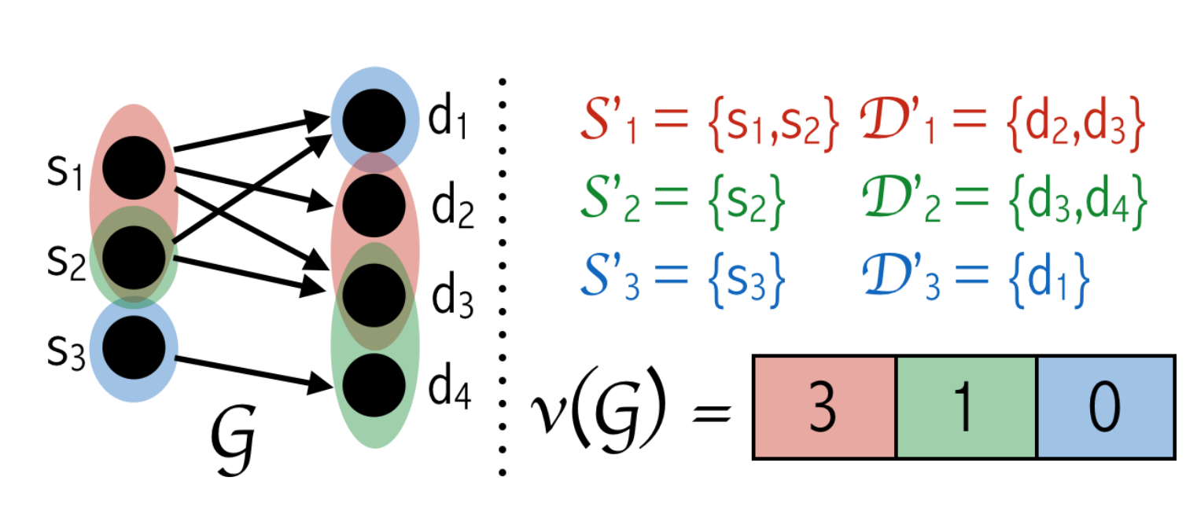
Baseline Approaches
SpotLight [2]
Composes a sketch containing total edge weights of K specific directed query subgraphs chosen independently and uniformly at random, according to node sampling probabilities, p for sources and q for destinations
StreamSpot[3]
Shingles are constructed using temporal ordered k-hop breadth-first traversal (OkBFT)
Uses Locality Sensitive Hashing (LSH) for sketching
﻿Fig: A (K=3,p=0.5, q=0.33)-SpotLight sketch of a graph G
﻿Fig: Shingling in StreamSpot using OkBFT

Slide 34
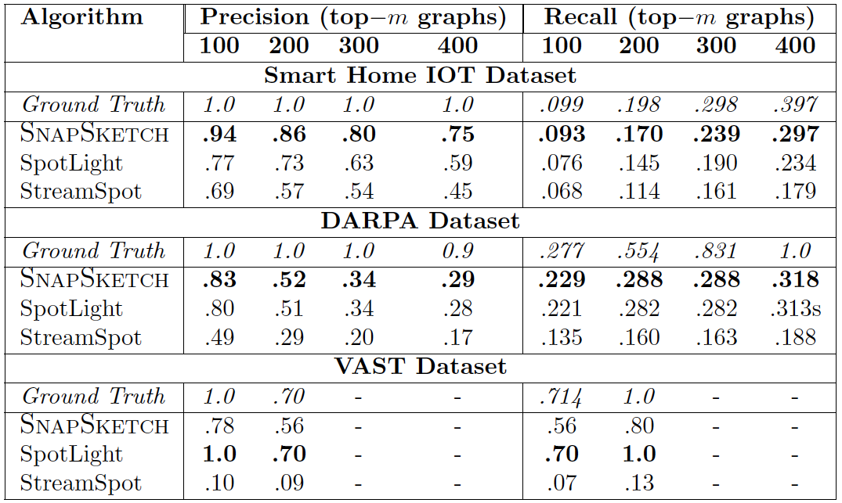
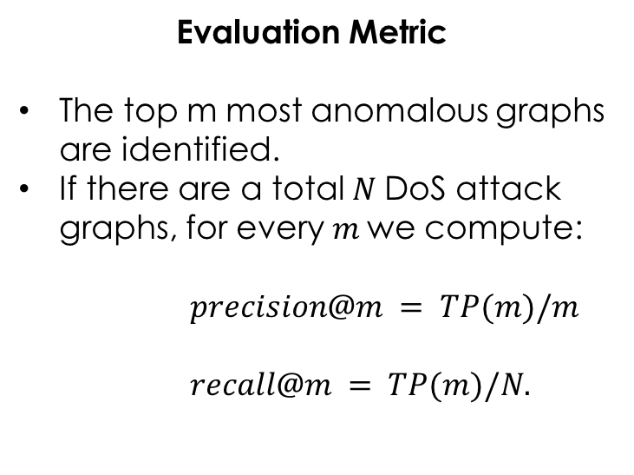
Results – Network Traffic
Evaluation Metric
The top m most anomalous graphs are identified.
If there are a total $N$DoS attack graphs, for every $m$we compute:
$$precision@m = TP(m)/m$$
$$recall@m = TP(m)/N.$$

Slide 35
Results – Smart Home IoT
Ramesh Paudel, Timothy Muncy, and William Eberle, “Detecting DoS Attack in Smart Home IoT Devices Using a Graph-Based Approach”, In Proceedings of the IEEE International Conference on Big Data. 2019
Fig: Anomaly score reported on smart home IoT traffic. Blue plot indicates the ground truth
anomalies. Spike in red plots indicates the anomaly score reported by the respective approaches.

Slide 36
Results – DARPA 1998
Fig: Anomaly score reported on DARPA 1998.

Slide 37
Results – VAST 2011
Fig: Anomaly score reported on VAST 2011.

Slide 38
Results – NYC Taxi Trip
Fig: Anomaly score reported on NYC Taxi Trip.

Slide 39
Summary
Presented a graph representation technique called SNAPSKETCH.
Sketching is done by hashing discriminative shingles constructed from a walk path of a biased-random walk.
SNAPSKETCH effectively represent graphs into a feature vector with efficient memory usage.
It performed well in graph classification.
It outperformed both the baseline anomaly detection approaches in detecting network anomalies.

Slide 40
Proposed Solution
Drift ?
Concept Drift Detection
Yes
G_{t}
Graph Stream
Graph Stream
Classification
y_{t}
Graph Representation
Sketch Vector
Ramesh Paudel and William Eberle, “An Approach For Concept Drift Detection in a Graph Stream Using Discriminative Subgraphs”, ACM Transaction on Knowledge Discovery from Data - 2020. (awaiting final reply)

Slide 41
Background
In a streaming scenario, data distribution can change over time.
Concept drift is the phenomenon of changing data distribution over time.
Due to concept drift, the machine learning model built on the historical data can be inconsistent with the current data, leading to a deterioration of the model performance.
An efficient learning model should consider concept drift and adapt to the new data.
Notes:
Example1:- with the evolution of a new research topic like an adversarial neural network, the
researcher traditionally working on machine learning (having co-authors related to machine learning)
will likely have new collaborators in the field of adversarial neural networks, forming an evolving
co-author network
Example 2: in a social network, the interactions for an individual constantly evolve
resulting in new connections and changed networks over time
Example 1: In automated industry production, if the drift occurs, the production quality after drift will degrade.
Example 2: In network intrusion, if the drift occur, we will loose the efficiency of the network.
Example 3: In measuring credit worthiness, if we could detect the drift, the chances of lending bad loan will be low.

Slide 42
Motivation
Numerous drift detection approaches are proposed for traditional data streams.
Limited research related to drift detection in graph stream.
Techniques | Algorithm | Problems
Drift Tolerant Classifiers | NSH Kernel [12] | Not a active drift detector
 | ARC-GS [18]
 | gEboost [19]
 | gSLU [20]
Drift Detector | Graph Entropy Method [8] | Supervised, not practical for live stream
 | Zambon et. al. [9] | Constrained by predefined prototype graph for graph embedding
Hence,
We need non-constrained and unsupervised concept drift detection approach
Notes:
In Real world scenario, drift occurs fast, detecting it after the drift happens will delay our effort in tackling it.

Slide 43
Discriminative Subgraph-base Drift Detection
(DSDD)
Discriminative Subgraph
Detection
Entropy
Calculation
Concept Drift Detection
Uses Minimum Description Length (MDL) principle to detect discriminative subgraphs .
Calculate entropy of a graph to measure its structural information content.
Uses density-ratio estimation on entropy series to detect drifts

Slide 44
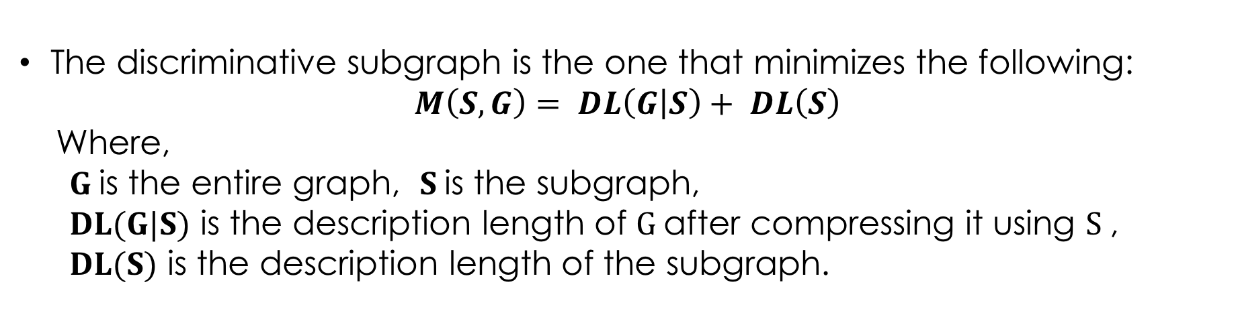
Discriminative Subgraph Generation
The discriminative subgraph is the one that minimizes the following:
$$M\left(S,G\right)= DL\left(G | S\right)+ DL\left(S\right)$$
Where,
$G$is the entire graph, $S$is the subgraph,
$DL(G|S)$ is the description length of $G$after compressing it using $S$,
$DL(S)$ is the description length of the subgraph.
Note:
The descriptive length of a graph G is the number of bits necessary to completely describe the graph.
Notes:
Discriminative subgraph: The subgraph that best compresses the original graph using the minimum description length.

Slide 45
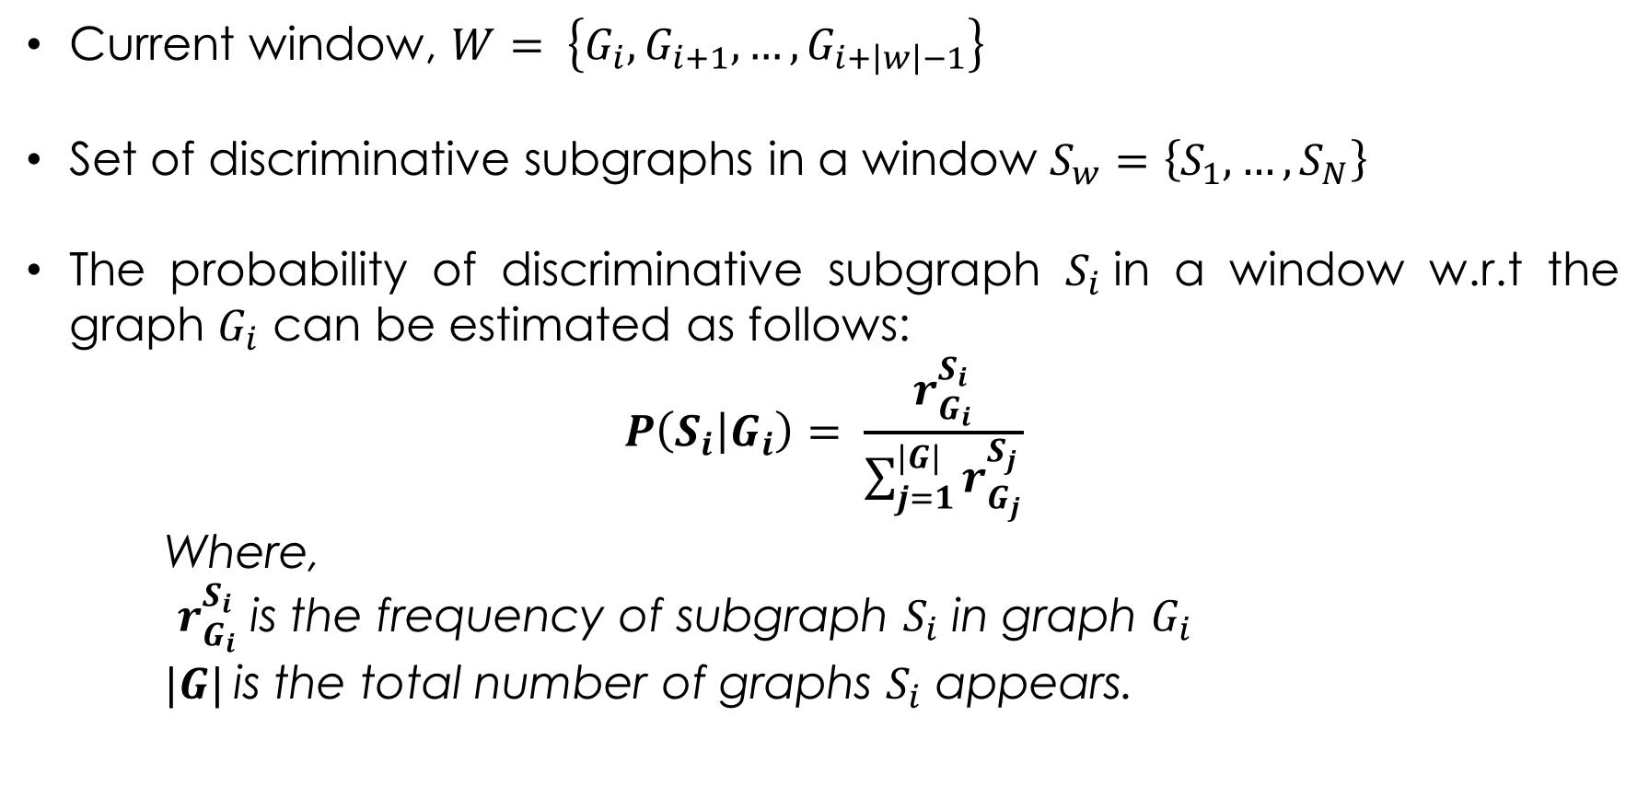
Window Entropy Calculation
Current window, $W= \left\{G_{i},G_{i+1}, …,G_{i+\left|w\right|−1}\right\}$
Set of discriminative subgraphs in a window $S_{w}=\left\{S_{1}, …,S_{N}\right\}$
The probability of discriminative subgraph $S_{i}$in a window w.r.t the graph $G_{i}$ can be estimated as follows:
$$P\left(S_{i} | G_{i}\right)= \frac{r_{G_{i}}^{S_{i}}}{\sum_{j=1}^{|G|}{r_{G_{j}}^{S_{j}}}}$$
Where,
$r_{G_{i}}^{S_{i}}$ is the frequency of subgraph $S_{i}$ in graph $G_{i}$
$|G|$is the total number of graphs $S_{i}$ appears.

Slide 46
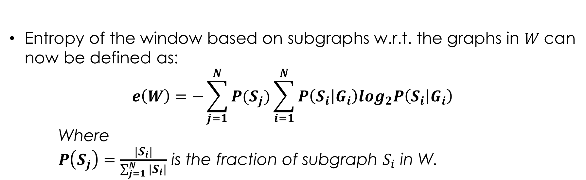
Window Entropy Calculation
Entropy of the window based on subgraphs w.r.t. the graphs in $W$can now be defined as:
$$e\left(W\right)=−\sum_{j=1}^{N}{P(S_{j})\sum_{i=1}^{N}{P\left(S_{i} | G_{i}\right)\log_{2}P\left(S_{i} | G_{i}\right)}}$$
Where
$P\left(S_{j}\right)=\frac{|S_{i}|}{\sum_{j=1}^{N}{|S_{i}|}}$ is the fraction of subgraph $S_{i}$ in W.

Slide 47
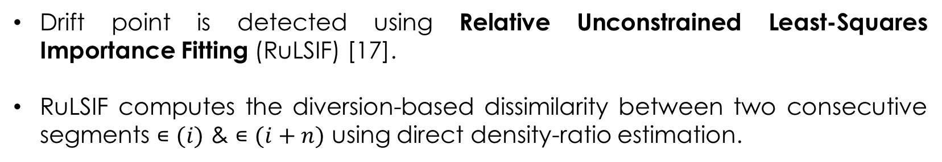
Concept Drift Detection
Drift point is detected using Relative Unconstrained Least-Squares Importance Fitting (RuLSIF) [17].
RuLSIF computes the diversion-based dissimilarity between two consecutive segments $∊(i)$ & $∊(i+n)$ using direct density-ratio estimation.
Notes:
Let $\left\{{…, e}_{t−2},e_{t−1},e_{t}\right\}$ be sequence of entropy values.
Let $E\left(i\right)=[e_{i},e_{i+1},…, e_{i+k−1}]$ be a sub-sequence of entropy series at time $i$with length k .
Let $∊(i)=\left\{E\left(i\right),E\left(i+1\right), …,E\left(i+n−1\right)\right\}$be a set of n retrospective sub-sequence samples at time $i$forming a Hankel matrix .

Slide 48
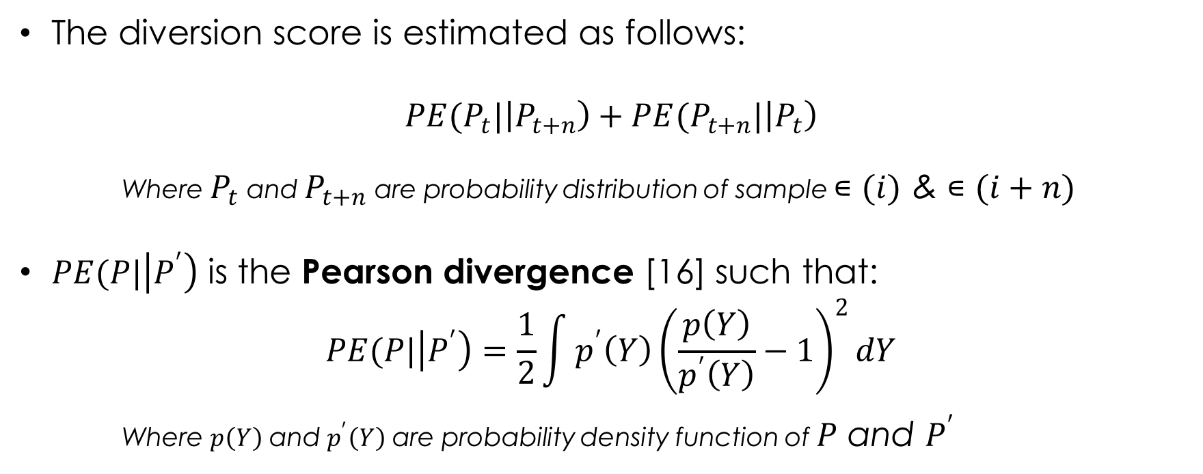
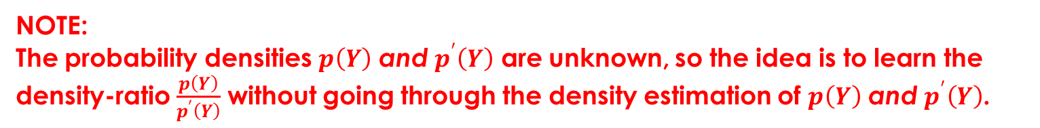
Diversion Score
The diversion score is estimated as follows:
$$PE(P_{t}|\left|P_{t+n}\right)+PE(P_{t+n}|\left|P_{t}\right)$$
Where $P_{t}$ and $P_{t+n}$ are probability distribution of sample $∊(i)$ & $∊(i+n)$
$PE(P|\left|P^{′}\right)$ is the Pearson divergence [16] such that:
$$PE(P|\left|P^{′}\right)=\frac{1}{2}\int{p^{′}\left(Y\right){\left(\frac{p\left(Y\right)}{p^{′}\left(Y\right)}−1\right)}^{2}dY}$$
Where $p\left(Y\right)$ and $p^{′}\left(Y\right)$ are probability density function of $P$ and $P^{′}$
NOTE:
The probability densities $p\left(Y\right)$ and $p^{′}\left(Y\right)$ are unknown, so the idea is to learn the density-ratio $\frac{p\left(Y\right)}{p^{′}\left(Y\right)}$ without going through the density estimation of $p\left(Y\right)$ and $p^{′}\left(Y\right)$.
Notes:
Symmetric PE divergence

Slide 49
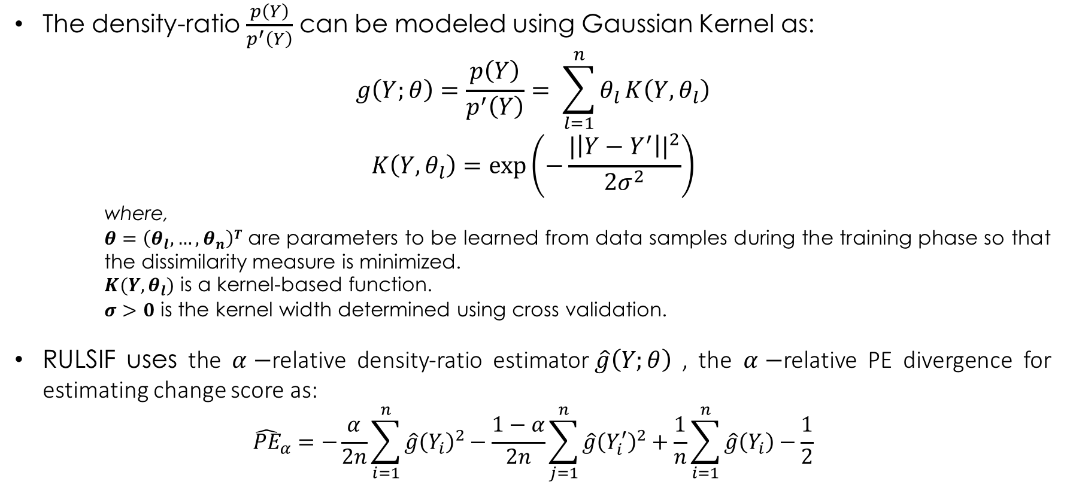
Drift Point Detection
The density-ratio $\frac{p\left(Y\right)}{p^{′}\left(Y\right)}$ can be modeled using Gaussian Kernel as:
$$g\left(Y;θ\right)=\frac{p\left(Y\right)}{p^{′}\left(Y\right)}= \sum_{l=1}^{n}{θ_{l}}K\left(Y,θ_{l}\right)$$
$$K\left(Y,θ_{l}\right)=exp\left(−\frac{{|\left|Y−Y^{′}\right||}^{2}}{2σ^{2}}\right)$$
where,
$θ=\left(θ_{l}, …,θ_{n}\right)T$ are parameters to be learned from data samples during the training phase so that the dissimilarity measure is minimized.
$K(Y,θ_{l})$ is a kernel-based function.
$σ>0$ is the kernel width determined using cross validation.
RULSIF uses the $α−$relative density-ratio estimator$\hat{g}\left(Y;θ\right)$ , the $α−$relative PE divergence for estimating change score as:
$${\hat{PE}}_{α}=−\frac{α}{2n}\sum_{i=1}^{n}{\hat{g}{\left(Y_{i}\right)}^{2}−\frac{1−α}{2n}}\sum_{j=1}^{n}{\hat{g}{\left(Y_{i}^{′}\right)}^{2}+\frac{1}{n}\sum_{i=1}^{n}{\hat{g}\left(Y_{i}\right)−\frac{1}{2}}}$$

Slide 50
Concept Drift Detection Workflow
Fig: Illustration of discriminative subgraph-based concept drift detection methodology.

Slide 51
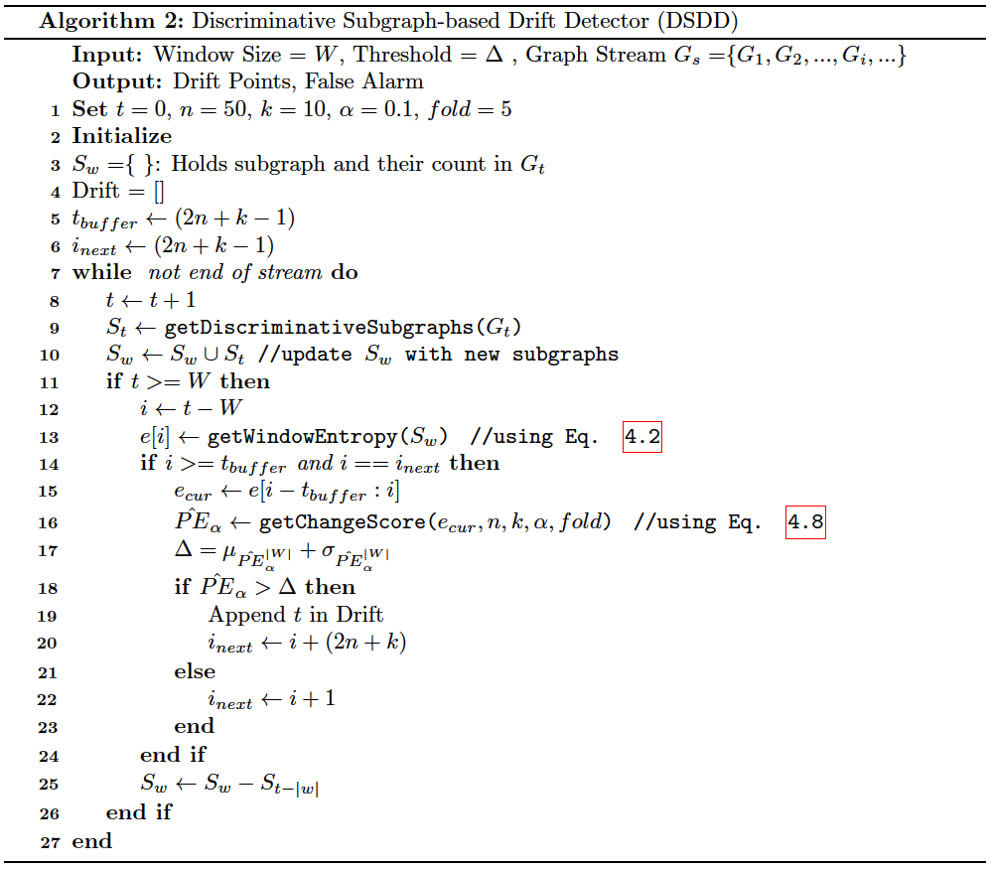
DSDD

Slide 52
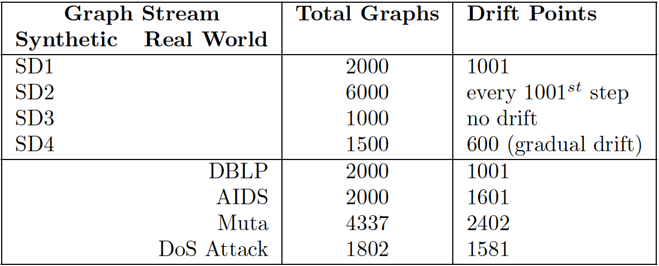
Dataset
Synthetic Graph Stream
4 synthetic graph streams (SD1, SD2, SD3, SD4) created using SUBGEN to simulate abrupt and gradual drift scenarios.
Real-world Graph Stream
4 real-world graph stream
DBLP citation network graphs belonging to CVPR and DBDM.
IAM Benchmark dataset (AIDS and Mutagenicity)
Network DoS attack dataset from VAST 2011 mini-challenge 2
Fig: Graphical structure of Inst-a and Inst-b used to generate synthetic dataset.
Notes:
DBLP Citation Network, AIDS, and Mutagenicity, the graph belonging from
class A to class B are sent in a 20:1 ratio until the
drift point. Then the ratio is altered from class B to class A.
For the DoS Attack dataset, the drift point is the beginning of the DoS attack,
as the traffic pattern before and after the DoS attack is likely to change.

Slide 53
Experiments
Performance Metrics
Drift detection rate (DDR)
Delay of detection (DoD)
FA1000: The rate of false anomalies within 1000 samples
Baseline Methods
Graph Entropy Method [8]: -
Sliding window to computes the entropy w.r.t. class.
A Cumulative Sum on the entropy sequence is used to detect drifts.
Zambon et al. [9]:
Embed each graph into a vector.
Hypothesis test to detect drifts.
Notes:
GEM: Consider edges as subgraphs.
Zambon: Embedding is done by computing dissimilarity between a graph and a prototype graphs.
DDR: Number of times change points are correctly detected by the number of all change points
DOD: Average time lapse between a real drift point and a true alarm.

Slide 54

Results – Synthetic Dataset
Table: Result obtained by DSDD on synthetic datasets under different window size W.
Notes:
Window size of 30 have best result
We use that size in real-world

Slide 55
Results – Synthetic Dataset
Fig: Entropy and change score on SD4 dataset. X-axis represents time t (shared by both plots). The vertical black lines in the entropy plot are the real drift point. The black plot on the change score plot is the threshold and vertical dotted blue lines are the detected drift points.
Notes:
Window size of 30 have best result
We use that size in real-world

Slide 56

Results – Real-world Dataset
Table: Result obtained by DSDD and baseline methods on real-world datasets W = 30).

Slide 57
Results – Real-world Dataset
Fig: Entropy and change score on Mutagenicity dataset

Slide 58
Summary
Proposed a novel unsupervised algorithm for drift detection on graph streams.
The unsupervised nature of DSDD makes it more robust in a streaming scenario.
Its competitive performance makes it a promising drift detection technique on graph streams.
Notes:
The proposed approach has the lowest drift detection delay with a 100% drift detection rate in all four real-world graph streams.

Slide 59
Core Research Outline
Drift ?
Drift Detector
Yes
G_{t}
Graph Stream
Graph Stream
Classification
y_{t}
Graph Sketching
Sketch Vector

Slide 60
Background
Challenges of a classification model in a graph stream:
Increasing graph volumes
Expanding feature space
One pass requirement
Concept drift
SNAPSKETCH
DSDD
Solution
An incremental classifier that uses the constant-space sketch vector generated by SNAPSKETCH and updates its parameter to adapt with the latest distribution of data by integrating a DSDD-based drift detector.

Slide 61

Graph Stream Classification Framework
For each graph $G_{t}$, SNAPSKETCH generates a sketch vector $v_{G_{t}}$
Classification is done in batches.
Sketch vectors of the first batch are used to train the model.
In subsequent batches, the class label is predicted and the model parameters are updated for the future batch.
If DSDD detects the drift, model parameters from old batches are ignored and the model is re-trained using the new batch.
Linear SVM is used as the classifier.
Linear SVM is trained in a stream-like fashion using Stochastic Gradient Descent.

Slide 62

Stochastic Gradient Descent [21]
Let us consider a supervised learning problem with training samples $\left(x,y\right)∈X×Y$ drawn from a probability distribution $P\left(x,y\right)$ where x is an arbitrary input and y is an output.
The cost of predicting $\hat{y}$ when the actual answer is $y$ is given by loss function $l(\hat{y},y)$.
We can try to estimate function $f∈F$, where $F$ is a weight parametrized function $f_{w}(x)$ that minimizes expected risk (risk in the future example)
$$E\left(f\right)=\int{l\left(f\left(x\right),y\right)dP(x,y)}$$
Since we are given training sample $\left(x_{i},y_{i}\right), i=1, .. .,n$, we can compute empirical risk (risk in the training set)
$$E_{n}\left(f_{n}\right)=\frac{1}{n}\sum_{i=1}^{n}{l(f\left(x_{i}\right),y_{i})}$$

Slide 63

Stochastic Gradient Descent [21]
Using SGD, we can minimize empirical risk instead of expected risk if F is sufficiently restrictive by updating weight $w$iteratively using time dependent weighting factor.
$$w_{t+1}=w_{t}−\frac{\text{η}}{t}\frac{δ}{δ_{w}}l(f_{t}\left(x_{t}\right),y_{t})$$
To train linear SVM using SGD, hinge loss $\left(l\left(z,y\right)=\max\left\{0, 1−yz\right\}\right)$ with $z=wx+b$ is used and minimizes the function:
$$\frac{λ}{2}{||w||}^{2}+\frac{1}{n}\sum_{i=1}^{n}{l(y_{i}\left(wx_{i}+b\right))}$$
Where $||w||$ is the regularization term representing the size of the margin in feature space
Embedding this function in SGD framework we get,
$$w_{t+1}=w_{t}−{\text{η}}_{t}(λw_{t}+\frac{δl(y_{t}(w_{t}x_{t}+b))}{δ_{w_{t}}})$$
where ${\text{η}}_{t}=\frac{1}{λ(t+t_{o})}$ and $λ$ and $t_{o}$ are user defined parameter

Slide 64
Dataset
Real-world Graph Stream
4 real-world graph stream
DBLP citation network graphs belonging to CVPR and DBDM.
IAM Benchmark dataset (AIDS and Mutagenicity)
Network DoS attack dataset from VAST 2011 mini-challenge 2
Synthetic Graph Stream
Uses synthetic graph stream SD2 as used in the experimentation of DSDD.

Slide 65
Experiments
Baseline Methods
Discriminative Clique Hashing (DICH) [10]: -Hash clique from an incoming graph and use the rule-based classifier
Nested Subtree Hashing (NSH) [12]: -Embedding algorithm that learns representation by hashing Weisfeiler-Lehman (WL) subtree patterns.
Incremental SVM (IncSVM) [11]: - Combine incremental SVM with WL-graph kernel.
NOTE:
SNAPSKETCH uses a shingle of size 3 (n = 3), walk length of 50 (l = 50), discriminative shingle of 64 (k = 64), and sketch dimension of 64 (d = 64).
All the experiments are conducted on a 2.6 GHz Intel Core i5 machine with 8 GB
1600MHz DDR3 memory size.

Slide 66

Results
Table: Overall classification accuracy using the proposed and the baseline approaches
Notes:
covid

Slide 67
Results
Fig: Accuracy comparison of SNAPSKETCH -based classier in SD2 graph stream before and
after integrating DSDD-based drift detector.

Slide 68
Results
Fig: Accuracy of SNAPSKETCH-based classier in real-world graph stream before and after
integrating DSDD-based drift detector

Slide 69
Summary
We proposed the framework for a large-scale graph classification over non-stationary graph streams.
The classification model is incrementally trained upon the arrival of a new batch of data.
By incorporating the DSDD-based drift detector, the model can be re-trained to match the latest distribution of the data so the model performance does not degrade.
Experiments on synthetic and real-world graph streams showed it’s superiority against related baseline methods.

Slide 70
Outline
Graph Mining Overview
Challenges
&
Motivation
Graph Representation
Concept Drift
Detection
Graph Stream
Classification
Conclusion

Slide 71
Conclusion
We proposed, SNAPSKETCH, an unsupervised general-purpose graph representation technique.
Sketch vector generated by SNAPSKETCH can be used for different downstream applications.
We proposed, DSDD, an unsupervised drift detection approach in graph stream.
Finally, integrating SNAPSKETCH and DSDD, we presented an incremental learning framework for graph stream classification.
Framework for graph stream classification can be re-trained to match the latest distribution of the data so the model performance does not degrade.
Experiments on synthetic and real-world graph streams showed it’s superiority against related baseline methods.

Slide 72
Future Works
SNAPSKETCH
A better approach for a random walk so we do not have to do an exhaustive random walk.
Include the structural information of the graph (number of neighbors, degree, etc.) in the cost vector instead of only neighborhood information.
Test the sketch vector for other applications like graph clustering, community detection, etc.
DSDD
Explore other less computationally subgraph extraction approaches.
Test more on the gradually drifting real-world graph streams to further evaluate the robustness of the proposed approach.

Slide 73
Publications
Journal
Ramesh Paudel and William Eberle, “An Approach For Concept Drift Detection in a Graph Stream Using Discriminative Subgraphs”, ACM Transaction on Knowledge Discovery from Data - 2020. (Accepted)
Conferences
Ramesh Paudel, Timothy Muncy, and William Eberle, “Detecting DoS Attack in Smart Home IoT Devices Using a Graph-Based Approach”, In Proceedings of the IEEE International Conference on Big Data. 2019
Ramesh Paudel, Prajjwal Kandel, and William Eberle, “Detecting Spam Tweets in Trending Topics using Graph-Based Approach”, In Proceedings of the Future Technology Conference - 2019.
Ramesh Paudel, Peter Harlan, William Eberle, “Detecting the Onset of a Network Layer DoS Attack with a Graph-Based Approach”, In Proceedings of the FLAIRS Conference. 2019
Ramesh Paudel, William Eberle, Lawrence Holder, “Anomaly Detection of Elderly Patient Activities in Smart Homes using a Graph-Based Approach”, In Proceedings of 2018 International Conference on Data Science. 2018
Ramesh Paudel, Kimberlyn Dunn, William Eberle, Danielle Chaung, “Cognitive Health Prediction on the Elderly Using Sensor Data in Smart Homes”, In Proceedings of the Thirty-First International FLAIRS Conference (FLAIRS-31). 2018
Ramesh Paudel, William Eberle, Doug Talbert, “Detection of Anomalous Activity in Diabetic Patients Using Graph-Based Approach”, In Proceedings of the Thirtieth International FLAIRS Conference (FLAIRS-30). 2017
Poster
Ramesh Paudel, William Eberle, “SNAPSKETCH: Network Representation Approach for Anomaly Detection in Dynamic Network”, RSA Security Conference, 2020
Ramesh Paudel, William Eberle, “An Approach For Concept Drift Detection in a Graph Stream Using a Discriminative Subgraph”, In Proceedings of Student Research and Creative Inquiry, 2019. (Best Poster Award)
Ramesh Paudel, James Park, William Eberle , “Mining Heterogeneous Graph for Patterns and Anomalies”, In Proceedings of Student Research & Creative Inquiry, 2018.

Slide 74
References
Guha, Sudipto, et al. "Robust random cut forest based anomaly detection on streams." International conference on machine learning. 2016.
Eswaran, Dhivya, et al. "Spotlight: Detecting anomalies in streaming graphs." Proceedings of the 24th ACM SIGKDD International Conference on Knowledge Discovery & Data Mining. ACM, 2018.
Manzoor, Emaad, Sadegh M. Milajerdi, and Leman Akoglu. "Fast memory-efficient anomaly detection in streaming heterogeneous graphs." Proceedings of the 22nd ACM SIGKDD International Conference on Knowledge Discovery and Data Mining. ACM, 2016.
A. Hamza, H. H. Gharakheili, T. A. Benson, and V. Sivaraman, “Detecting volumetric attacks on lot devices via sdn-based monitoring of mud activity,” in Proceedings of the 2019 ACM Symposium on SDN Research. ACM, 2019, pp. 36–48.
A. Grover and J. Leskovec, “node2vec: Scalable feature learning for networks,” in Proceedings of the 22nd ACM SIGKDD international conference on Knowledge discovery and data mining. ACM, 2016, pp. 855–864.
Ramesh Paudel and William Eberle, “An Approach For Concept Drift Detection in a Graph Stream Using Discriminative Subgraphs”, ACM Transaction on Knowledge Discovery from Data - 2020. (Accepted)
Ramesh Paudel, Timothy Muncy, and William Eberle, “Detecting DoS Attack in Smart Home IoT Devices Using a Graph-Based Approach”, In Proceedings of the IEEE International Conference on Big Data. 2019
Yao, Yibo and Holder, Lawrence B. “Detecting concept drift in classification over streaming graphs." In KDD Workshop on Mining and Learning with Graphs (MLG), San Francisco, CA," pages 2134-2142, 2016.

Slide 75
References
Zambon, Daniele, Alippi, Cesare, and Livi, Lorenzo. “Concept drift and anomaly detection in graph streams." IEEE transactions on neural networks and learning systems , volume 29, no. 99, pages 1-14, 2018.
Chi, Lianhua, Li, Bin, Zhu, Xingquan, Pan, Shirui, and Chen, Ling. Hashing for adaptive real-time graph stream classfication with concept drifts." IEEE transactions on cybernetics ,volume 48, no. 5, pages 1591-1604, 2018.
Yao, Yibo and Holder, Lawrence. Scalable svm-based classification in dynamic graphs." In 2014 IEEE International Conference on Data Mining (ICDM)," pages 650-659. IEEE, 2014
Li, Bin, Zhu, Xingquan, Chi, Lianhua, and Zhang, Chengqi. Nested subtree hash kernels for large-scale graph classification over streams." In Data Mining (ICDM), 2012 IEEE 12th International Conference on," pages 399-408. IEEE, 2012.
Shervashidze, Nino, Schweitzer, Pascal, Leeuwen, Erik Jan van, Mehlhorn, Kurt, and Borgwardt, Karsten M. Weisfeiler-lehman graph kernels." Journal of Machine Learning Research , volume 12, no. Sep, pages 2539-2561, 2011
Narayanan, Annamalai, Chandramohan, Mahinthan, Venkatesan, Rajasekar, Chen, Lihui, Liu, Yang, and Jaiswal, Shantanu. graph2vec: Learning distributed representations of graphs.” arXiv preprint arXiv:1707.05005 , 2017.
Adhikari, Bijaya, Zhang, Yao, Ramakrishnan, Naren, and Prakash, B Aditya. Distributed representations of subgraphs." In \2017 IEEE International Conference on Data Mining Workshops (ICDMW)," pages 111-117. IEEE, 2017.
Pearson, Karl. \X. On the criterion that a given system of deviations from the probable in the case of a correlated system of variables is such that it can be reasonably supposed to have arisen from random sampling." The London, Edinburgh, and Dublin Philosophical Magazineand Journal of Science , volume 50, no. 302, pages 157-175, 1900.

Slide 76
References
Liu, Song, Yamada, Makoto, Collier, Nigel, and Sugiyama, Masashi. Change-point detection in time-series data by relative density-ratio estimation." Neural Networks , volume 43, pages 72-83, 2013.
Pan, Shirui, Wu, Jia, Zhu, Xingquan, and Zhang, Chengqi. Graph ensemble boosting for imbalanced noisy graph stream classication." IEEE Trans. Cybernetics, volume 45, no. 5, pages 940-954, 2015.
Chi, Lianhua, Li, Bin, Zhu, Xingquan, Pan, Shirui, and Chen, Ling. Hashing for adaptive real-time graph stream classification with concept drifts." IEEE transactions on cybernetics , volume 48, no. 5, pages 1591-1604, 2018.
Pan, Shirui, Zhu, Xingquan, Zhang, Chengqi, and Philip, S Yu. Graph stream classification using labeled and unlabeled graphs." In Data Engineering (ICDE), 2013 IEEE 29th International Conference on," pages 398-409. IEEE, 2013.
Bottou, Leon. Large-scale machine learning with stochastic gradient descent." In Proceedings of COMPSTAT'2010," pages 177-186. Springer, 2010.

Slide 77




